Slide 1
SMS SPAM DETECTION USING MACHINE LEARNING
DEEPIKA BALAKRISHNAN C
MES20MCA-2015
PRODUCT OWNER-Mr. MOHAMMAD JABIR C

Slide 2
TABLE OF CONTENTS
CONTENT | PAGE
Introduction | 4-5
Modules | 6-7
Data Flow Diagram | 8-10
Methodology | 11-20
Developing Environment | 21
Project Plan | 22

Slide 3
User Story | 23
Product Backlog | 24
Sprint plan | 25-26
Sprint Actual | 27-32
Screenshots | 33-36

Slide 4
INTRODUCTION
Short Message Service (SMS) is one of the popular communication services in which a message is sent electronically. The reduction in the cost of SMS services by telecom companies has led to the increased use of SMS. This rise attracted attackers which have resulted in SMS Spam problem. A spam message is generally any unwanted message that is sent to user’s mobile phone. Spam messages include advertisements, free ser-vices, promotions, awards, etc. People are using SMS messages to communicate rather than emails because while sending SMS message there is no need of internet connection and it is simple and efﬁcient.
The SMS Spam problem is increasing day by day with the increase in the use of text messaging. There are various security measures available to control SMS Spam problem but they are not so mature. Many android apps are also on play store to block spam messages but people are not aware of these apps due to lack of knowledge. Other than apps the ﬁltering techniques available mainly focuses on email spam as email spam is one of the oldest problem but with the popularity of mobile devices, SMS spam is the one of the major issue these days.
SMS is one of the cheapest ways to communicate and can be considered as the simplest way to perform phishing attacks as mobile devices contain sensitive and personal information like card details, username, password, etc. Attackers are ﬁnding different ways to steal this information from mobile devices and SMS is one of the easiest ways. Smishing i.e. SMS based Phishing is more

Slide 5
popular these days in which user sends malicious link via SMS and asks user to visit that link and steals sensitive information from user’s mobile device. There are various detection approaches available for detecting mobile phishing like QR code, machine learning based, biometric based, matrix code reader based, knowledge based and authentication based.
SMS spammers can purchase any mobile number with any area code to send spam messages so that it becomes difﬁcult to identify the attacker.
In this proposed approach main aim is to ﬁlter the spam and ham SMS using machine learning algorithms. Machine learning techniques were effective in email spam ﬁltering as it helps in preventing zero-day attacks and provides the high level of security. The Same approach is being used for mobile devices in order to prevent from SMS Spam problem but in the case of SMS Spam features will be different from email spam as the size of the text message is small and the user uses less formal language for text messages. And text message is simple without any graphic content and attachments.

Slide 6
MODULES
TECHNICAL:
Dataset
Training and model building
Data cleaning using stemmer
Token generation
Spam core generation
Test accuracy
Output generation
ADMIN:
Login
View user list
Manage user
Block user
View blocked user

Slide 7
USER:
Register
Login
Search friends
Send friend request
Manage friend request
View friend list
Chat with friends
View messages and replay message
View status (Spam / Ham)

Slide 8
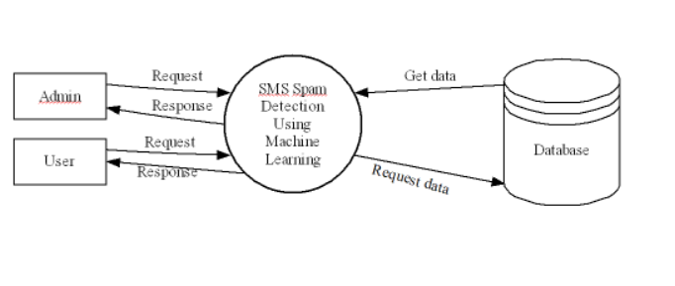
DATA FLOW DIAGRAM
LEVEL 0:

Slide 9
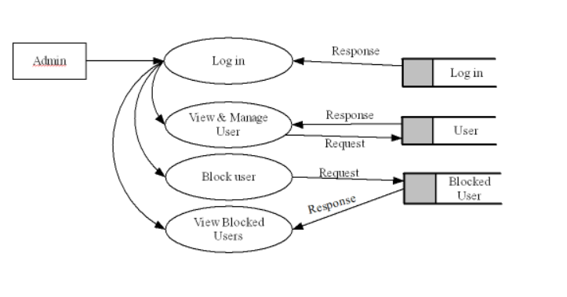
LEVEL 1:

Slide 10
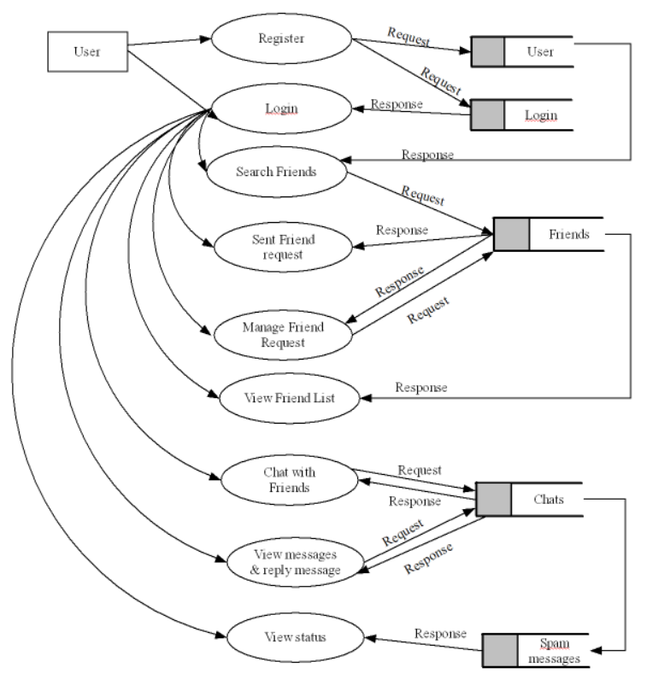
LEVEL 2:

Slide 11
METHODOLOGY
The project SMS Spam Detection Using Machine Learning two modules one is Admin module and second is User module. The admin can enter the data through the web into the database. Admin can add user, view users and manage users. The user can register through the application by giving the details. After logging into the application user moves to the homepage of the website. User can send friend requests, find friends and manage friend requests, chat with friends, view chats and reply the messages. User can view the chat messages is spam or ham through the status. When we read the chat messages, it checks whether the message is spam or ham by reading the complete data in the dataset. It read the data and place it in a data frame called trained data. Then we attach new message into the trained data. After that we preprocess the data in each rows in the data set .while preprocessing we remove the html tag and short notes, eliminate stop words, remove characters and numerical. After removing all these we get some keywords. we pass these keywords to a training section SVM to train it. After training we add currently sending messages into it and preprocess it.it checks the features taking from this message is matched with which all messages features is matching with this message in the dataset. Then we classify whether the message is ham or spam with the help of SVM. The output we are getting from the prediction is updated into the status field.

Slide 12
Work Flow
Data Collection:
In this phase authors have collected a dataset based on which they have performed the experimentation from Kaggle Repository.
Data Cleaning:
In this phase the authors have cleansed all the data which were taken into consideration. Authors have removed all the white-spaces, lowered the alphabet so that words like Equal and equal become the same, remove the remaining punctuation, like! is not that much important, tokenize each message, to represent the message as a list of words and done stemming, converting all the words to their root word, like floor, floored to floor.
Generating Testing and Training Data Sets:
Authors have created the testing and training data on the converted cleansed datasets.

Slide 13
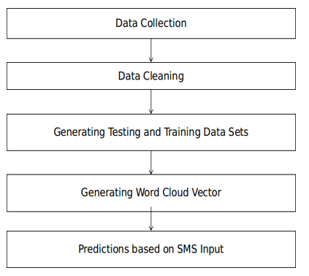
Generating Word Cloud Vector:
Authors have used the TF-IDF vectorization for creating the word-vector. On the basis, thespam feature will be classified.
Prediction:
Authors have given input messages to check whether the message is SPAM or HAM.
Figure 3.1 shows the workflow or architectural layout of how authors have classified the SPAM.

Slide 14
Machine Learning
Machine learning is a fascinating domain as it incorporates substantial parts of different fields namely statistics, artificial intelligence theory, data analytic and numerical methods. Machine learning can be defined as semi-automated extraction of knowledge from data sets or data.
Let’s break down the definition into three component parts.
Firstly, machine learning always starts with data, with an objective to extract knowledge insight from the used data or data set.
Secondly, machine learning involves a certain amount of automation rather than trying to gather insights from the data manually.
Lastly, machine learning is not fully automated i.e. it requires human interventions to make many smart decisions for the process to be successful.
Simply we can put, machine learning is an application that can improve its prediction results with successive iterations or it improves with experience. The process of an application improving with

Slide 15
experience is, naturally enough, called Training. It can take significant iterations to gradually improve results. During the process of training, data is given to a machine learning algorithm, which then refines its internal representation, numerical parameters, as it encounters any deviations or Training errors. The purpose of this stage is to minimize cost function, error function or maximizing likelihood by adjusting the algorithm’s internal weights. When the algorithm accuracy improves, we call this learning. Once the results are accurate enough also known as scoring, the machine-learning application can be deployed to solve the problem that it was supposed to.
Machine learning is broadly categorized into two categories:
Supervised Learning,
Unsupervised Learning.

Slide 16
Supervised Learning:
Supervised learning also known as predictive modelling, is the process of making predictions using data. Examples of Supervised learning are Classification and Regression. A supervised learning Training data set is pre labelled for classification problems or function values are known in case of regression. After training is done and the model has a minimum cost function for the training data set, later switch for scoring where we can predict values for new data.
Classification:
It identifies group membership. That means that if we have multiple events characterized by input parameters, which can be labelled differently, and we want our system to predict which label should be used.
Regression:
Regression is a combination of multi-dimensional power supply and function interpolation. The regression problem is used to find the approximation of the function with a minimum error deviation

Slide 17
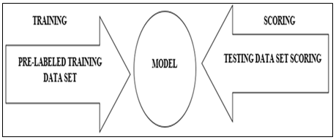
or a cost function. In other words, the regression technique simply tries to predict numeric dependence, a function value, for example, of a data set. Figure Diagrammatically shows how supervised learning is to solve problems
Example of supervised learning, if a system has a data set which is a series of email messages, supervised learning task is to predict whether each email message is spam or non-spam ( ham). This is supervised learning because there is a specific outcome namely spam or ham.

Slide 18
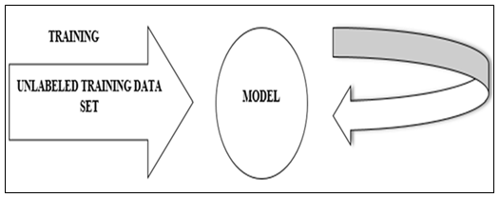
Unsupervised Learning:
Unsupervised Learning is the process of extracting structure from data or how to best represent data. Examples of Unsupervised Learning are Clustering7 (is partitioning a data set into meaningful similar sub classes called cluster) and Association8 (method for discovering relations between existing attributes within a data set or data base). In an unsupervised learning situation, where the algorithm detects data features automatically, this depends on the purpose of the algorithm as well as the assumptions made on what the properties and observed values are. Figure Describes how unsupervised learning is used to solve problems.

Slide 19
For example, if any data set was the characteristics and purchasing behavior of shoppers at grocery stores, the unsupervised learning task might be to segment the shoppers into groups or “clusters” that exhibit similar behaviors. Such learning methods might find that college students, parents with young children, and older adults have characteristic shopping behaviors that are similar within each group but dissimilar from the other. This is an unsupervised learning task because there is no right or wrong about how many clusters can be found in the data, which people belong in which cluster, or even how to describe each cluster.
Now after having a clear understanding of Machine Learning, authors have used the same in generating the rules, which will help in governing or identifying based on inputs whether or not the message is SPAM or HAM. For processing the document content authors have used TF-IDF.

Slide 20
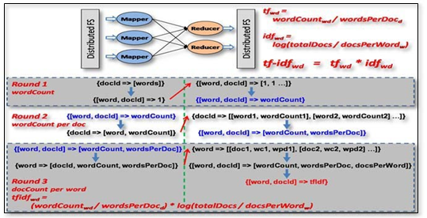
Term Frequency Inverse Document Frequency (TF-IDF)
TF-IDF stands for Term Frequency Inverse Document Frequency, used in machine learning and text mining as a weighting factor for identifying words features. The weight increases as the word frequency in a document increases, i.e. weight increases, the more times a term occurs in the document, but that offset by the number of times the word appears, in the entire data set or this offset helps remove the importance from really common words like ‘the’ or ‘a’ appear quite often in all across the document. It is used very often in relevance ranking and scoring and to move stop words from ML Model, where these stop words don’t give any relevant information about a particular document type or class. Figure represents the TF-IDF mathematical formula.

Slide 21
DEVELOPING ENVIRONMENT
• Hardware Requirements
Processor : i3 and above
RAM : 4GB
Storage : 500GB Hard disk
• Software Requirements
Front End: HTML, CSS,
Back End: Python, MYSQL
IDE: : JetBrains PyCharm
FRAMEWORK USED: Flask

Slide 22
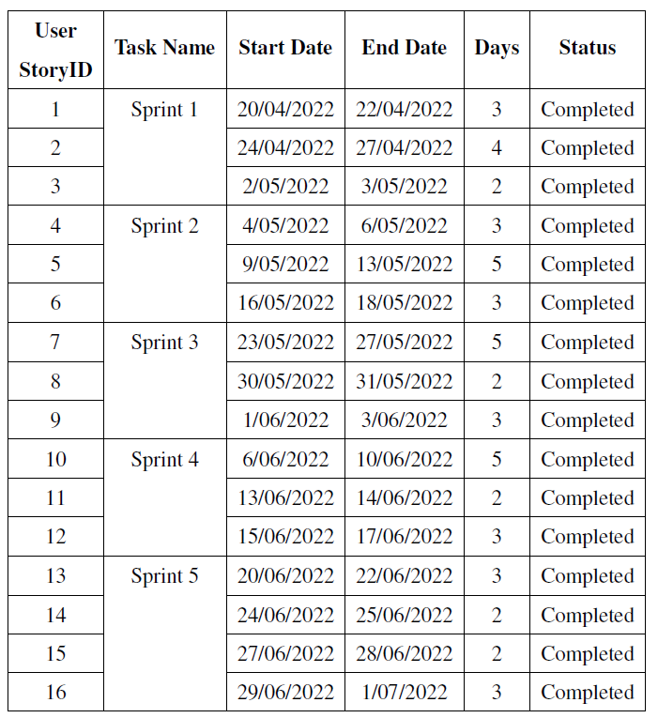
PROJECT PLAN

Slide 23
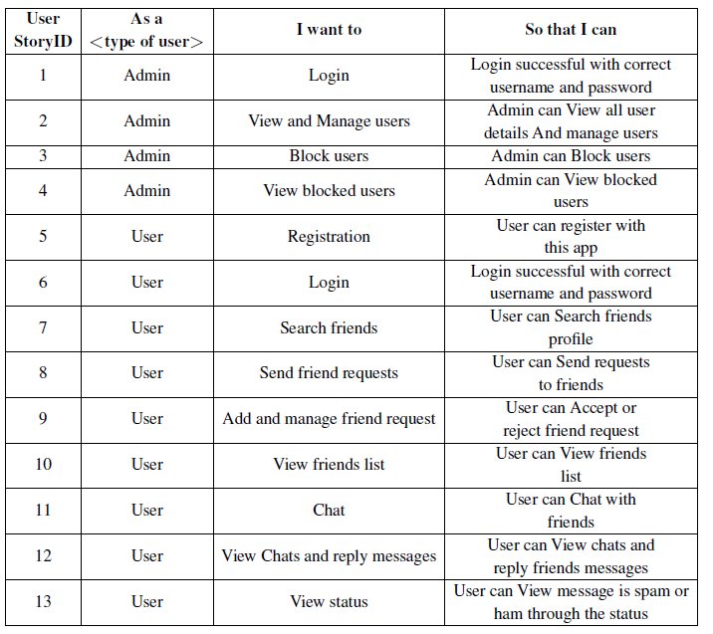
USER STORY

Slide 24
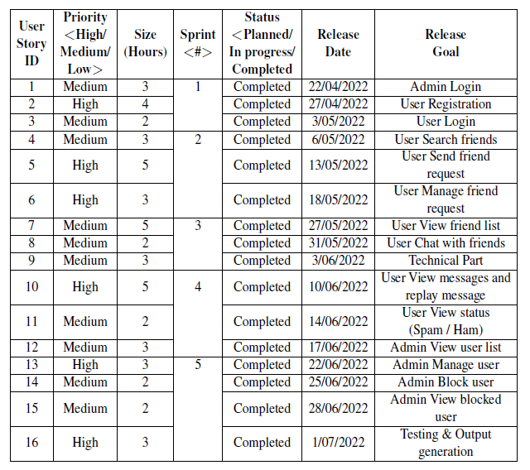
PRODUCT BACKLOG

Slide 25
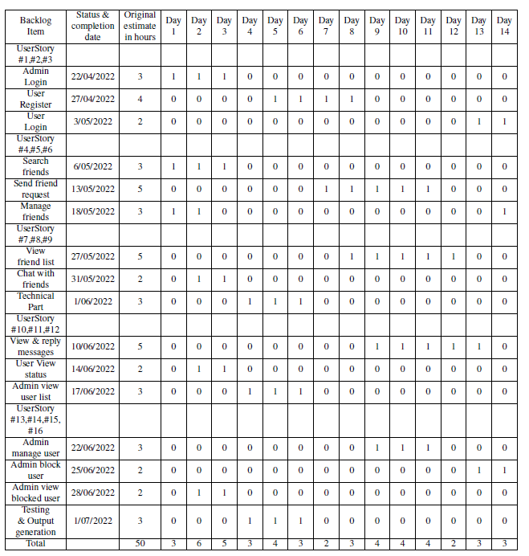
SPRINT PLAN

Slide 27
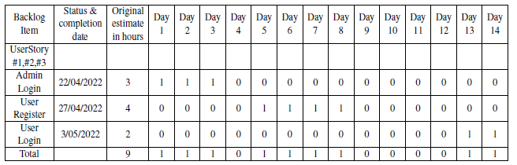
SPRINT ACTUAL 1

Slide 28
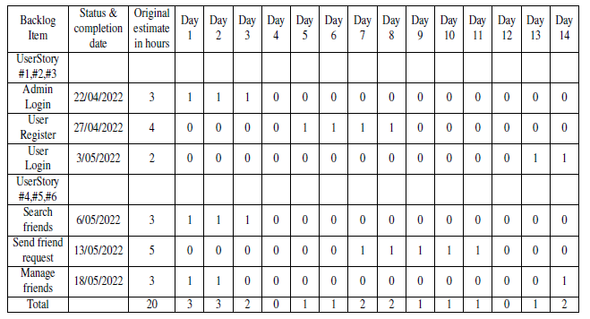
SPRINT ACTUAL 2

Slide 29
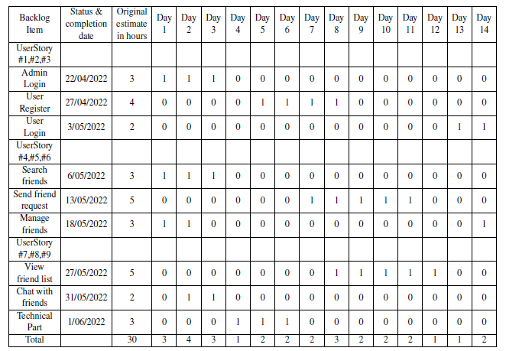
SPRINT ACTUAL 3

Slide 30
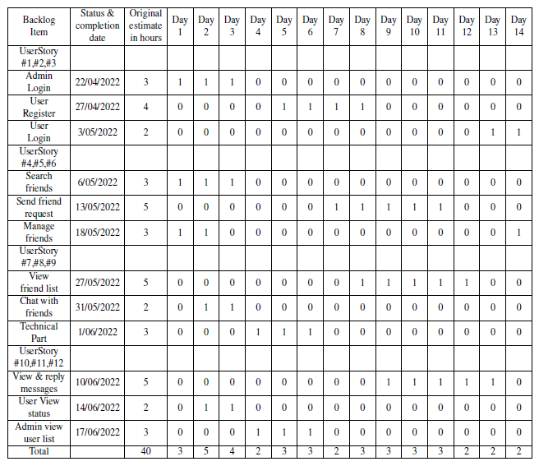
SPRINT ACTUAL 4

Slide 31
SPRINT ACTUAL 5

Slide 33
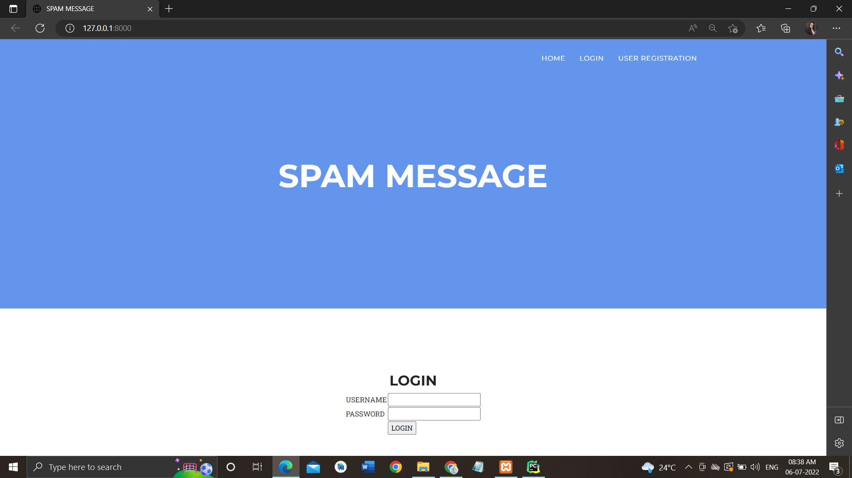
SCREENSHOTS
LOGIN PAGE

Slide 34
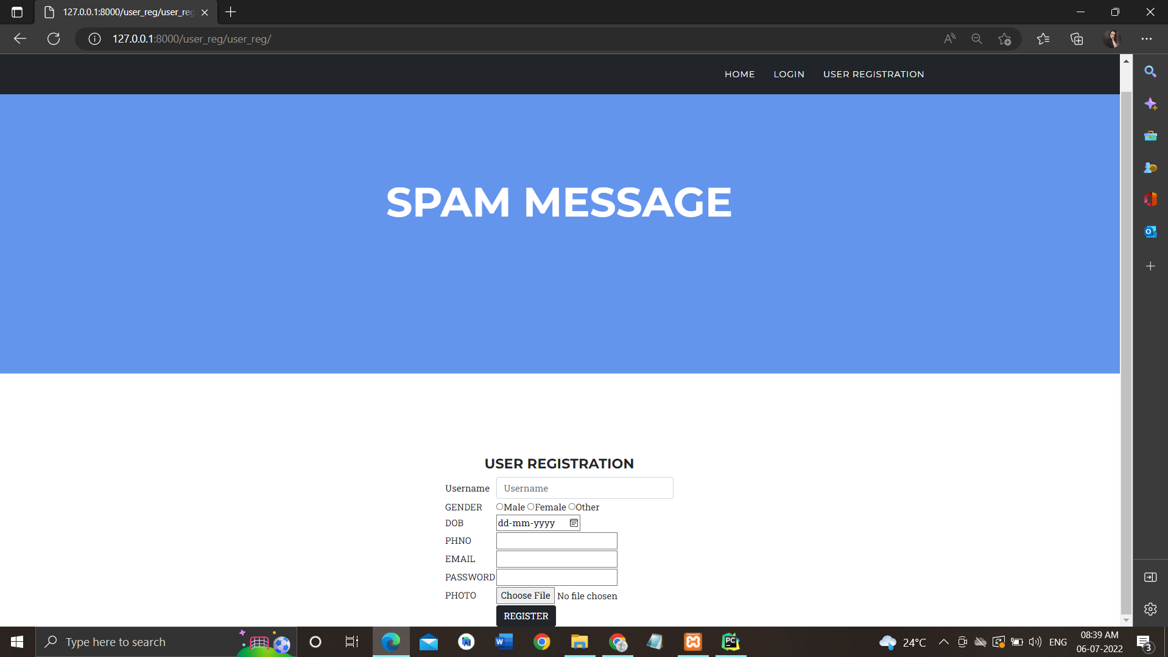
REGISTRATION PAGE

Slide 35
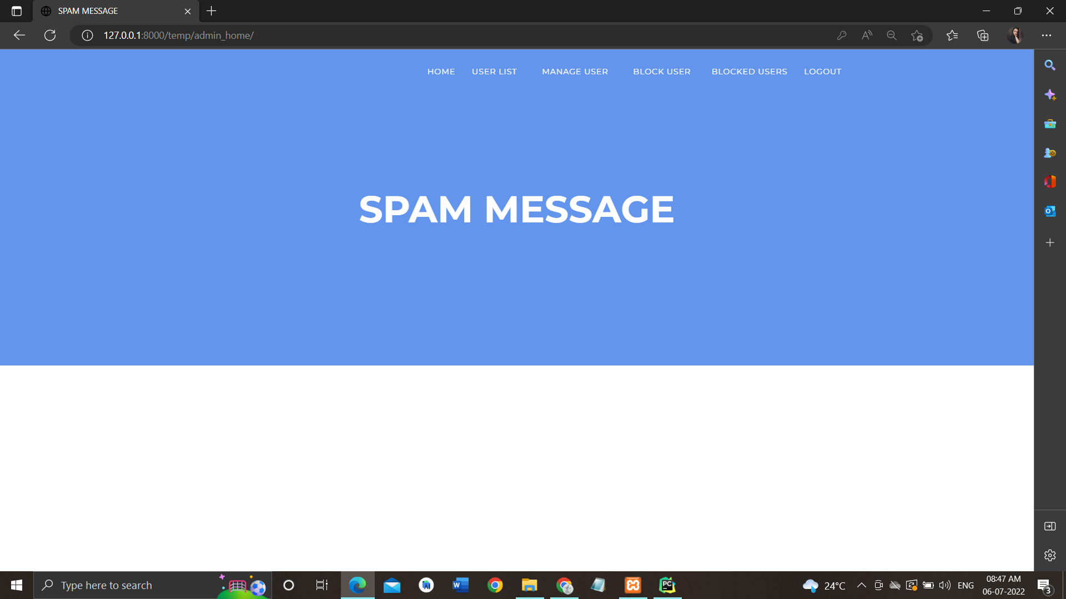
ADMIN HOME

Slide 36
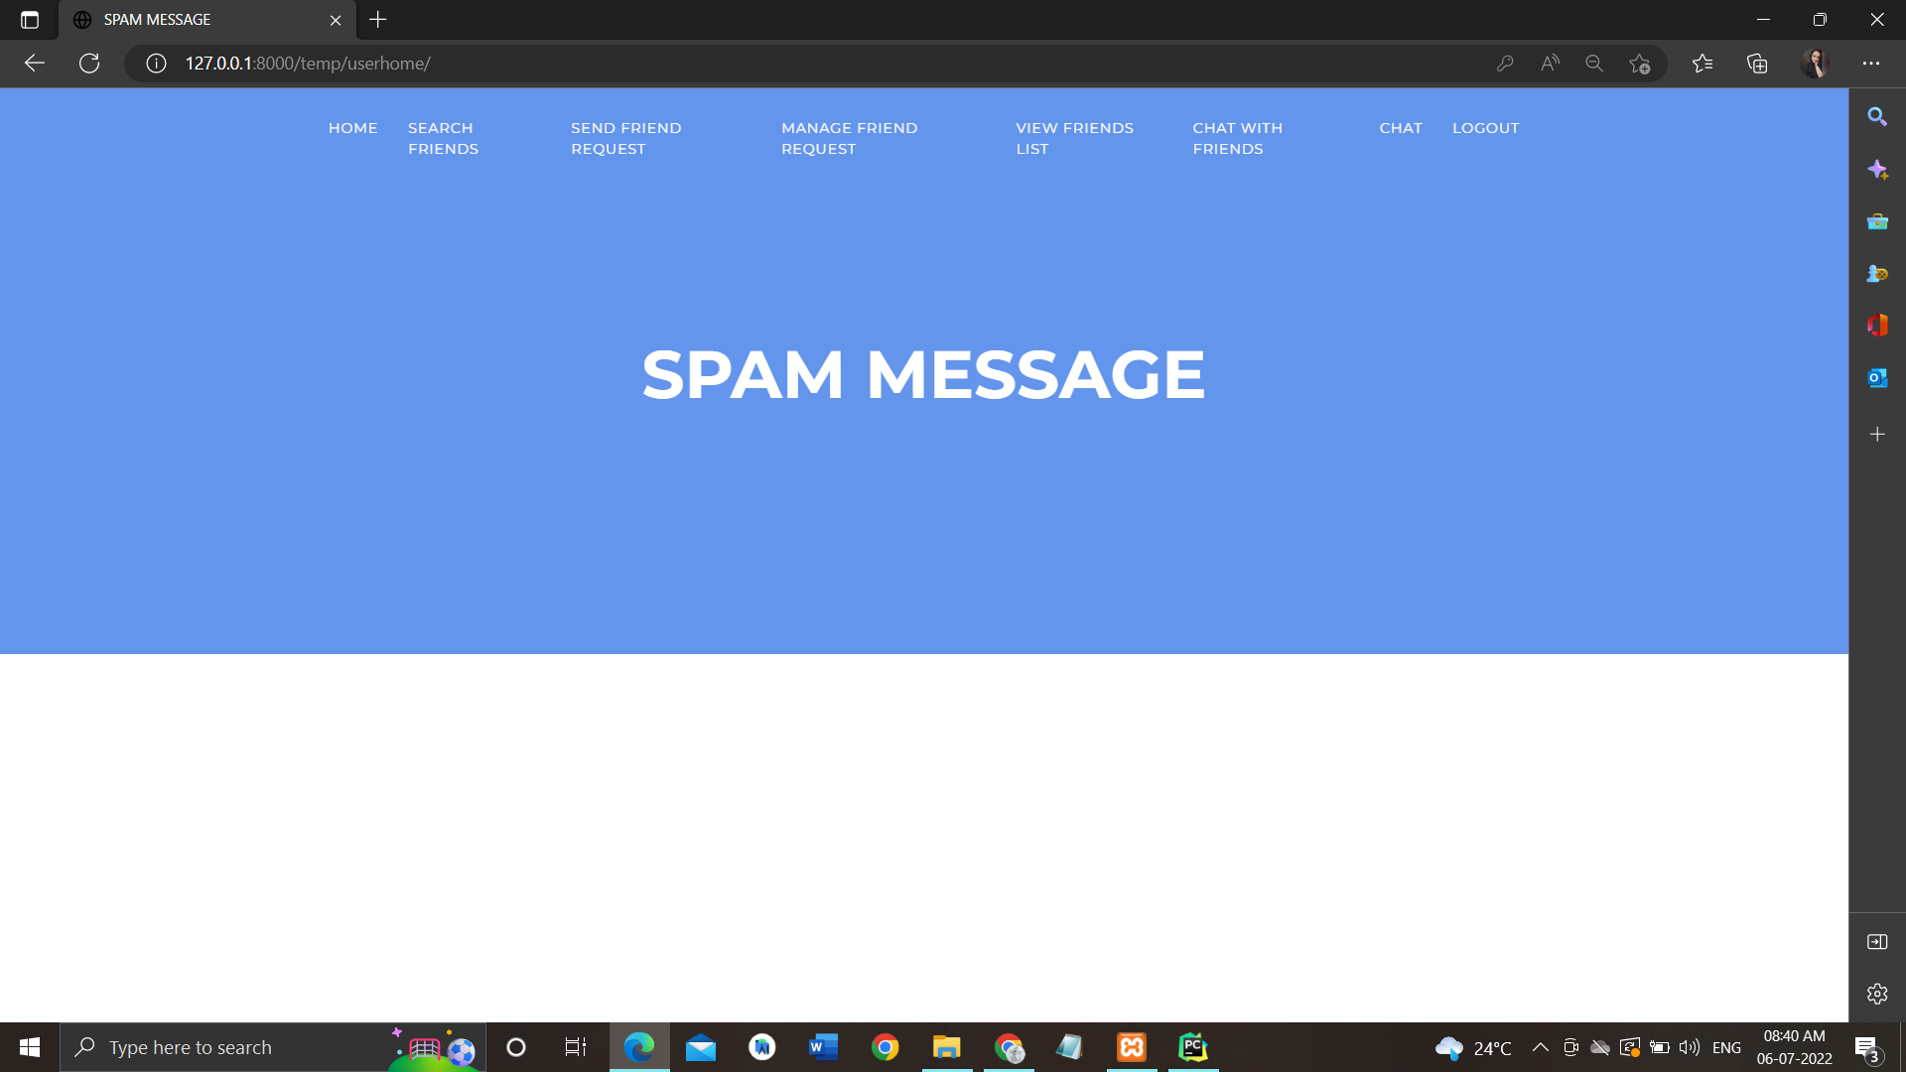
USER HOME

Slide 37
THANK YOU

